Slide 1

Financial Tracker App

Slide 2

PURPOSE AND AUDIENCE
The Tracker web application helps individuals and organizations track, analyze, and optimize their charitable donations.
It provides users with tools to manage:
  Donations & Transactions
  Budgets and Wallets
  Fundraising Goals
  Category-based spending analysis
  Dashboard analytics and performance insights
Target Audience
Donors — individuals or small NGOs who want to track contributions and see the impact of their giving.
Organizations — nonprofits seeking transparency for donation management.

Slide 3
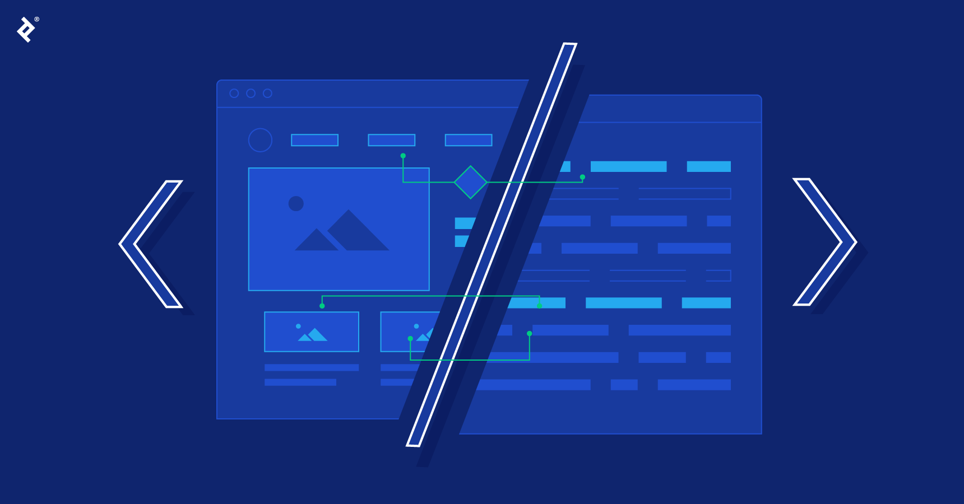
TECHNICAL APPROACH
LAYER | TECH STACK | PURPOSE/AIM
FRONTEND | React + TypeScript, Redux Toolkit, Tailwind CSS, React-Bootstrap, Recharts | UI, state management, responsive dashboards
BACKEND | ASP.NET Core 8 (C#), EF Core, FluentValidation, Identity, Redis (cache) | API, business logic, authentication, analytics
DATABASE | SQL Server (Azure SQL Edge ready) | Persistent data store
CACHE LAYER | Redis (via IDistributedCache) | Speed up analytics, reduce DB load
SECURITY | JWT Auth, Refresh Tokens, Bot Detection Middleware | Secure API Access

Slide 4
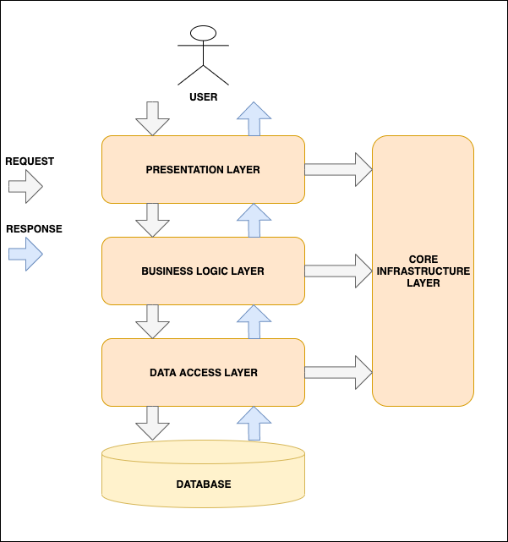
ARCHITECTURE OVERVIEW
THE N-TIER ARCHITECTURE
Key Architectural Features
Separation of Concerns → API, Core, DB layers completely decoupled.
Centralized CacheInvalidationService for efficient analytics refresh.
Dependency Injection ensures modular and testable services.
FluentValidation guarantees clean DTO inputs before DB hits.
JWT Auth + Refresh Tokens for secure session handling.
BotDetectionService adds lightweight traffic hygiene.
Notes:
Below is how every request flows through your DonationsTracker API from a security point of view, based on your current architecture (ASP.NET Core 8 + N-tier pattern + middleware stack + BotDetectionService + validation + JWT):
┌──────────────────────────────────────────────────────────────┐
│ Client / Request Origin │
│ └──> (Browser / Mobile / API Client / Bot / Test Runner) │
└──────────────────────────────────────────────────────────────┘
│
▼
┌──────────────────────────────────────────────────────────────┐
│ 1️⃣ ASP.NET Core Middleware Pipeline │
│ - HTTPS redirection │
│ - CORS policy check │
│ - Security headers (CSP, X-Frame-Options, etc.) │
│ - Rate limiting / throttling (future extension) │
└──────────────────────────────────────────────────────────────┘
│
▼
┌──────────────────────────────────────────────────────────────┐
│ 2️⃣ Authentication & Authorization │
│ - Validates JWT via JwtBearerDefaults scheme │
│ - Verifies signature, expiry, issuer, and audience │
│ - Rejects if token invalid → 401 Unauthorized │
└──────────────────────────────────────────────────────────────┘
│
▼
┌──────────────────────────────────────────────────────────────┐
│ 3️⃣ Controller Filter Layer (Attribute Level) │
│ - `[Authorize]` on protected endpoints │
│ - `[ApiController]` adds automatic model validation │
│ - `[FromBody]` & `[FromQuery]` enforce type-safe binding │
└──────────────────────────────────────────────────────────────┘
│
▼
┌──────────────────────────────────────────────────────────────┐
│ 4️⃣ Bot Detection & Input Sanitization Layer │
│ - `BotDetectionService.IsSuspiciousRequest()` │
│ Checks: │
│ ▫ Empty or malicious User-Agent (bot, crawler, etc.) │
│ ▫ Suspicious headers (curl, httpclient, postman) │
│ - Rejects with 400 if triggered │
│ - XSS sanitization: strips `<script>` tags, HTML entities │
└──────────────────────────────────────────────────────────────┘
│
▼
┌──────────────────────────────────────────────────────────────┐
│ 5️⃣ Business Logic Layer (Core Service) │
│ - Validates data constraints │
│ - Applies business rules (amount > 0, unique emails) │
│ - Prevents ORM overposting (maps only allowed fields) │
└──────────────────────────────────────────────────────────────┘
│
▼
┌──────────────────────────────────────────────────────────────┐
│ 6️⃣ Data Access Layer (Repository/EF Core) │
│ - Parameterized SQL → prevents SQL injection │
│ - DB schema constraints validate integrity │
│ - EF migrations enforce consistent schema │
└──────────────────────────────────────────────────────────────┘
│
▼
┌──────────────────────────────────────────────────────────────┐
│ 7️⃣ ApiResponse Builder │
│ - Wraps data into structured JSON │
│ - Adds timestamp + requestId + pagination info │
│ - Never exposes stack traces or raw exception messages │
└──────────────────────────────────────────────────────────────┘
│
▼
┌──────────────────────────────────────────────────────────────┐
│ 8️⃣ Outgoing Response Pipeline │
│ - Serialized using safe JSON options (no cycles) │
│ - Response headers sanitized (no Server, no ASP.NET tag) │
│ - Compression & CORS enforced again │
└──────────────────────────────────────────────────────────────┘
│
▼
✅ **Final JSON Response Sent to Client**
. Security Checks for a GET Request
Example:
GET /api/donation?page=1&limit=10
🔐 Step-by-Step Security Evaluation
Step
Layer
Security Check
Purpose
1
Transport Layer
HTTPS enforced (UseHttpsRedirection)
Prevents MITM and sniffing
2
CORS
Origin, method, and header validation
Prevents cross-domain abuse
3
JWT Authentication
Token verified (signature, expiry)
Ensures requester is legitimate
4
Authorization Attribute
[Authorize]
Restricts to logged-in users
5
BotDetectionService
Examines User-Agent
Blocks crawlers/spam harvesters
6
Input Validation
Query params page, limit coerced to int
Prevents parameter injection
7
Pagination Sanitization
Page ≥ 1, Limit ≤ max (e.g., 100)
Prevents DoS through massive queries
8
Business Logic
DB query limited & filtered
Prevents data leakage / over-fetching
9
Response Normalization
Returns ApiResponse<List<Donation>>
Prevents raw data or stacktrace exposure
🧠 Result:
Unauthorized users → 401 Unauthorized
Bots or malformed headers → 400 Bad Request
Valid users → 200 OK with sanitized pagination metadata
🧱 3. Security Checks for a POST Request
Example:
POST /api/donation
{ "description": "<script>alert('x')</script>", "amount": 25.5 }
🔐 Step-by-Step Security Evaluation
Step
Layer
Security Check
Purpose
1
Transport Layer
HTTPS
Encryption in transit
2
CORS
Origin verification
Prevents CSRF from untrusted sites
3
JWT Authentication
Token signature, expiration check
Ensures authenticated origin
4
Authorization Attribute
[Authorize]
Blocks anonymous donation creation
5
Bot Detection Service
User-Agent inspection
Rejects bots/spam submissions
6
Model Binding
Parses and validates body
Rejects malformed JSON automatically
7
Input Sanitization
Strips <script> tags
Prevents XSS payload persistence
8
Server-side Validation
e.g., Amount > 0, required fields
Prevents logical abuse / fraud
9
ORM-level Protection
EF Core parameterization
Eliminates SQL injection risk
10
ApiResponse Wrapping
Hides internal details
Prevents leakage of stack traces
11
CreatedAtRoute(201)
Proper REST semantics
Confirms safe, successful insert
🧠 Result:
Bot request → 400 Bad Request + VALIDATION_ERROR
Malformed JSON → 400 Bad Request + Invalid Model
Invalid token → 401 Unauthorized
Valid user + clean input → 201 Created + Sanitized Response

Slide 5
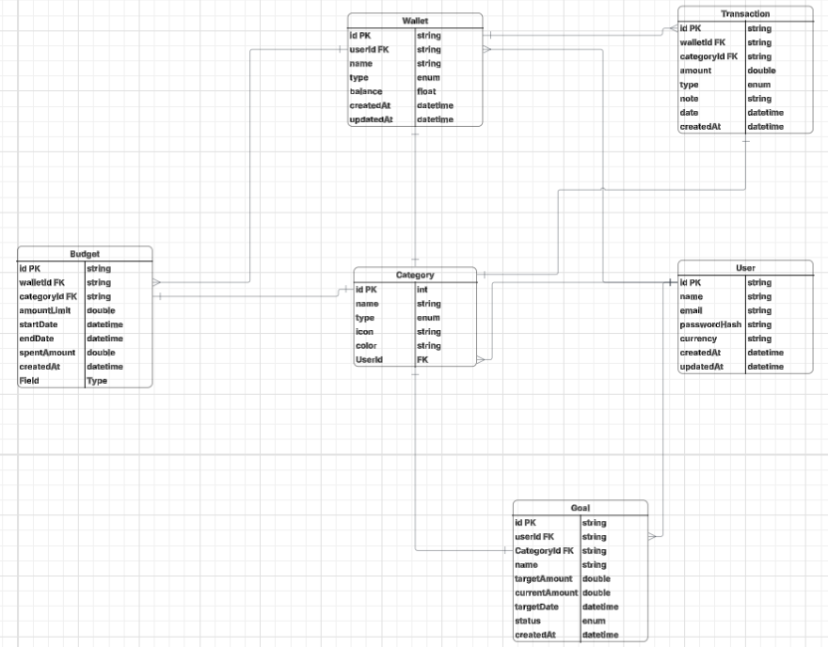
DESIGN MODELS
Relationships
User -> Wallets ->A user can have multiple wallets.
Wallet -> Transactions -> Each wallet contains many transactions.
User -> Budgets/Goals/Categories -> Personalized per user.
Transactions reference Categories for classification.
AnalyticsService aggregates across all entities for dashboard metrics.

Slide 6

PERFORMANCE AND SCALABILITY
Backend
Implemented Redis caching for analytics queries (2× faster response times).
Asynchronous EF Core calls for non-blocking database access.
Batched DB queries to reduce round trips (especially in AnalyticsService).
Pagination on transaction lists to avoid over-fetching.
Frontend
Memoized selectors and Redux Toolkit slices to prevent redundant re-renders.
Code splitting and lazy loading for routes.
Recharts optimized with minimal reflow for dashboard updates.
FingerprintJS used only on load (not every API call) to minimize overhead.

Slide 7

KEY CHALLENGES AND HOW THEY ARE ADDRESSED
Challenge | Description | Resolution
Caching consistency | Dashboard & Full Analysis cache keys needed synchronization | Introduced unified cache prefix + CacheInvalidationService
Mixed styling frameworks | Tailwind & Bootstrap CSS conflicts | Scoped styles + proper load order fixes
Token refresh flow | Early invalidation caused logout loops | Implemented token rotation & refresh retries
Redis TTL tuning | Short TTL caused stale UI data | Balanced TTL (2 min) + manual invalidation on writes

Slide 8
IMPROVEMENTS AND ENHANCEMENT
Frontend Performance
Add Service Workers for offline mode.
Implement React Query for smarter caching of API data.
Bundle analysis + image optimization for faster load.
Backend Scalability
Migrate analytics processing to background jobs (Hangfire/Quartz).
Introduce CQRS pattern for better query isolation.
Use read replicas or caching tiers for analytics endpoints.
Add rate limiting and health checks for production readiness.
Functional Enhancements
Add Recurring Donations and Charity Campaign tracking.
Integrate Payment APIs (Stripe/PayPal) for real transactions.
Add User Roles (Admin/Donor) with role-based dashboards.
Notes:
The Command Query Responsibility Segregation (CQRS) design pattern separates the operations that modify data (commands) from the operations that retrieve data (queries). This segregation allows for independent optimization and scaling of read and write operations within an application.
Benefits of CQRS:
Improved Performance and Scalability:
Optimizing and scaling read and write operations independently can lead to better overall system performance.
Enhanced Security:
Different security policies can be applied to commands and queries, providing finer-grained access control.
Increased Flexibility:
Allows for the use of different data storage technologies and optimization strategies for reads and writes.
Clearer Separation of Concerns:
Promotes a cleaner architecture by distinctly separating the responsibilities of data modification and data retrieval.
React-Query
In essence, React Query allows developers to declaratively manage server state, letting them focus on building application features while the library handles the underlying complexities of data management.
Simplifies Data Fetching:
It abstracts away the boilerplate code often needed for data fetching, such as managing loading states, error states, and data storage with useState and useEffect.
Automatic Caching:
React Query automatically caches fetched data, reducing the need for repeated network requests and improving application performance. It also handles background refetching to keep data fresh.
Server State Management:
Unlike client-side state management libraries (like Redux or Context API), React Query focuses specifically on server state, which involves asynchronous operations, caching, and synchronization with a remote source.
Hooks for Interaction:
It provides intuitive hooks like useQuery for fetching data and useMutation for creating, updating, or deleting data, making it easy to interact with the library's capabilities.
Handles Complex Scenarios:
React Query offers robust solutions for advanced scenarios such as pagination, infinite scrolling, and optimistic updates.
Improved User Experience:
By efficiently managing data fetching and caching, it makes applications feel faster and more responsive to users.
Reduced Code Complexity:
It helps eliminate repetitive and error-prone code related to data fetching and state management, leading to more maintainable applications.
READ REPLICA
A read replica is a read-only copy of a primary database that is used to improve performance and availability. It offloads read-heavy workloads from the primary database, preventing it from becoming overwhelmed and allowing it to focus on write operations. Data is replicated from the primary to the replica in near real-time, though there may be a slight delay.
Key functions and benefits
Scalability:
Read replicas allow you to scale out read capacity beyond the limits of a single database instance.
Performance:
By directing read-intensive queries to the replica, you can reduce the load on the primary database and decrease query latency.
Availability:
Read replicas can be promoted to become a new primary instance in case of a primary database failure, providing a high-availability solution. They can also be placed in a different availability zone or region to improve resilience against outages.
Offloading analytics:
Complex queries or analytical tasks can be run on read replicas without impacting the performance of the main transactional database.
Data redundancy:
They provide an extra layer of data redundancy, as they are an exact copy of the primary database.
How it works
Replication:
The primary database sends data changes to the read replica, which then applies them. This process is asynchronous, meaning the primary doesn't wait for the replica to apply changes before completing its own operation.
Read-only:
You cannot write data directly to a read replica. All write operations must be directed to the primary database.
Lag:
Due to the asynchronous nature of the replication, there can be a lag between the primary and the replica, which is usually a few seconds but can increase depending on workload and network latency.

Slide 9

Summary
The Tracker demonstrates:
A full-stack, production-grade donation management system.
Secure JWT-based authentication and session management.
Caching strategy that significantly boosts performance.
Clean, modular architecture designed for scalability and maintainability.

Slide 10


